Slide 1
Dr. John Wade Intelligent Systems Research Centre, School of Computing, Engineering & Intelligent Systems Ulster University, Magee, Derry
Brain Inspired Hardware Self-Repair

Slide 2
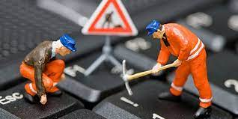
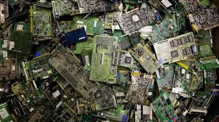
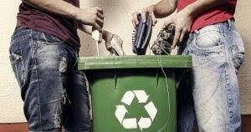
Self-Repair Background
Manual
Automatic/ Self Repair
Faulty Components
Radiation exposure
Damage
Repair/ Replace
Waste
Faulty Hardware

Slide 3

Challenges and Approaches
Challenges
Scalability
Reliability
Area Overhead
Mapping

Slide 4
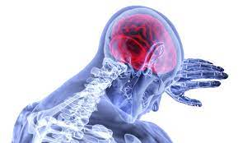
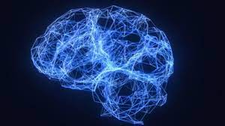
Biological Self-Repair Inspitation
Trauma
Stroke
Degradation
Reconfiguration
Relearning
Brain Injury
Brain Repair

Slide 5
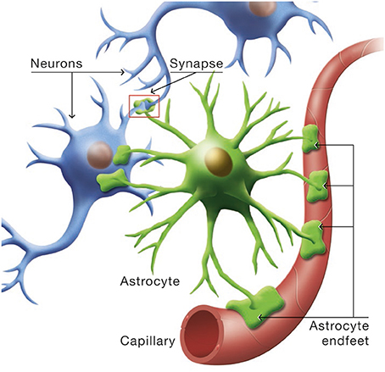
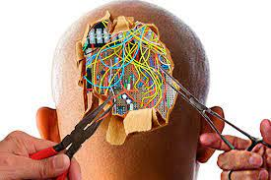
Autonomous Self-Repair (Astrocytes and Neurons)
Neurons
Astrocytes
Interactions
Tripartite synapse

Slide 6
Autonomous Self-Repair (Tripartite Synapse)
Glu release is all or nothing event
Direct Pathway
DSE: Decrease PR
Indirect Pathway
e-SP: Increase PR
Endocannabinoid Mediated Self Repair Single Synapse

Slide 7
Autonomous Self-Repair Endocannabinoid Mediated Self Repair: Network Level
DSE: Direct Suppression of Excitation
(PR: Decrease)
e-SP: Indirect increase of PR
Healthy State After Damage
Wade et al. 2012 Self Repair in a bidirectional coupled astrocyte-neuron (AN) system based on retrograde signalling. Frontiers in Comp. Sci.

Slide 8
Autonomous Self-Repair Endocannabinoid Mediated Self Repair: Network Level Results
10 Synapses each
2-AG (DSE)
N1
e-SP
2-AG
N2
Three faulty synapses where the fault is induced at time 200s. (D,E) Demonstrates the PR of the remaining nonfaulty synapses increasing to compensate for the net loss the other synapses of, thereby restoring the functionality of N2.
Wade et al. 2012 Self Repair in a bidirectional coupled astrocyte-neuron (AN) system based on retrograde signalling. Frontiers in Comp. Sci.
Restoration of N2 firing rate

Slide 9
Hardware Implemented Self-Repair
N2 under 80% fault density with temporary Faults
Liu et al. 2018. SPANNER: A Self-Repairing Spiking Neural Network Hardware Architecture. IEE Trans NN & Learn Sys
SPANNER: FPGA Implementation

Slide 10
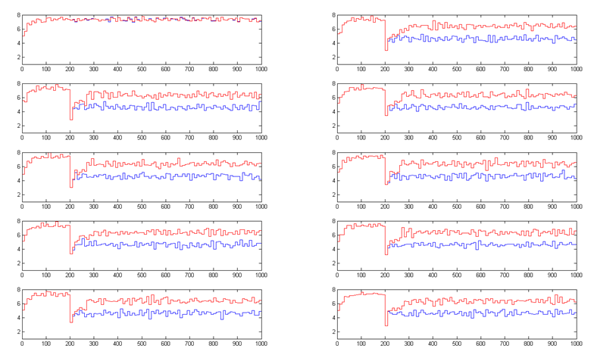
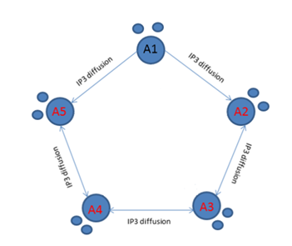
Distributed Self-Repair
Muhammad et al. IEEE Transactions on Neural Networks and Learning Systems 2015

Slide 11
Endocannabinoid Mediated Self Repair:
Improving Repair: BCM-STDP
Need to consider Probability of Release in STDP rule
- used the BCM rule
δω
p
∆t
d
Liu et al. 2017. Self-Repairing Learning Rule for Spiking Astrocyte-Neuron Networks. LNCS Vol 10639
Liu et al. 2018. Exploring Self-Repair in Coupled Spiking Astrocyte Neural Network. IEE Trans NN & Learn Sys

Slide 12
Improved Self-Repair: Inclusion of Learning
Liu et al. 2017. Self-Repairing Learning Rule for Spiking Astrocyte-Neuron Networks. LNCS Vol 10639
Liu et al. 2018. Exploring Self-Repair in Coupled Spiking Astrocyte Neural Network. IEE Trans NN & Learn Sys

Slide 13
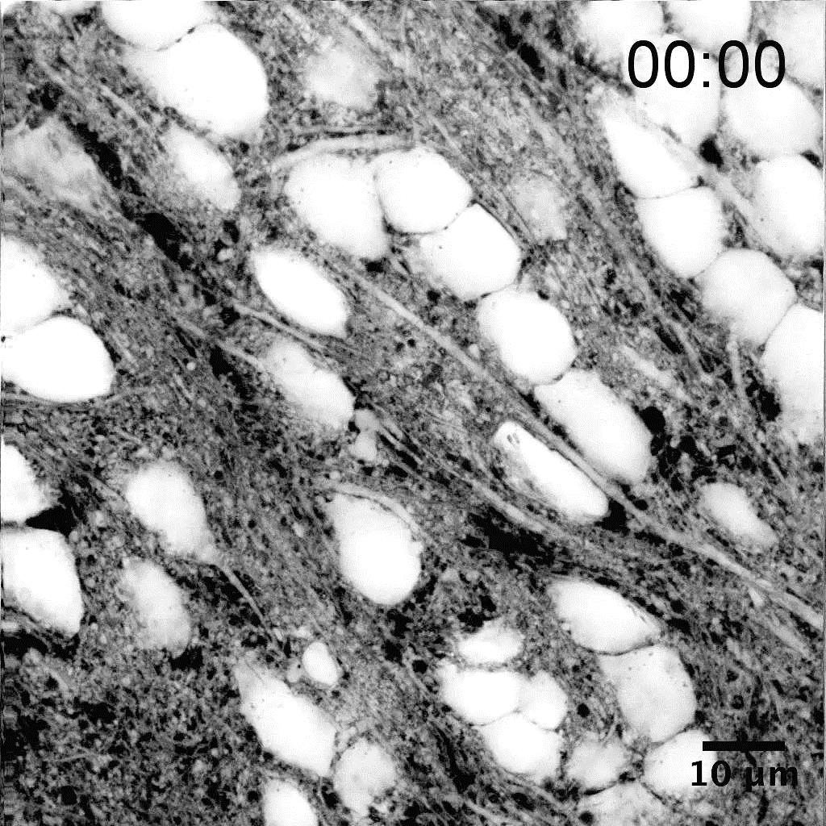
Microglia Cells: a new player in self repair
Originally hypothesized to function solely as immunologic responders within the central nervous system (CNS).
Emerging evidence has revealed that microglia have more complex roles in normal brain development and in the context of disease
Microglia Brain function

Slide 14
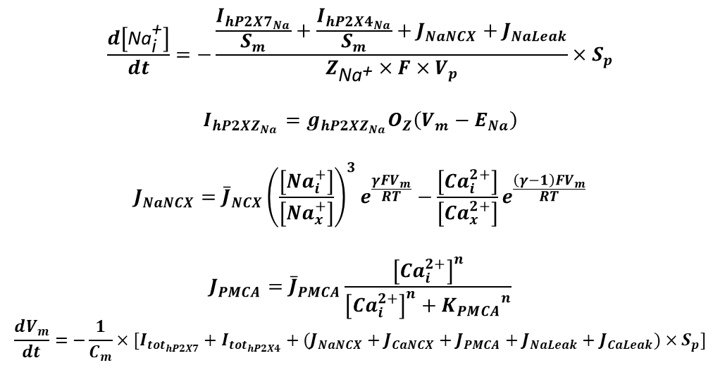
Microglia Cells: a new player in self repair
$$\frac{d\left[{\text{Na}}_{\text{i}}^{\text{+}}\right]}{dt}=−\frac{\frac{I_{{hP2X7}_{Na}}}{S_{m}}+\frac{I_{{hP2X4}_{Na}}}{S_{m}}+J_{NaNCX}+J_{NaLeak}}{Z_{{\text{Na}}^{\text{+}}}×F×V_{p}}×S_{p}$$
$$I_{{hP2XZ}_{Na}}=g_{{hP2XZ}_{Na}}O_{Z}\left(V_{m}−E_{Na}\right)$$
$$J_{NaNCX}={\overline{J}}_{NCX}{\left(\frac{\left[{Na}_{i}^{+}\right]}{\left[{Na}_{x}^{+}\right]}\right)}^{3}e^{\frac{γFV_{m}}{RT}}−\frac{\left[{Ca}_{i}^{2+}\right]}{\left[{Ca}_{x}^{2+}\right]}e^{\frac{\left(γ−1\right)FV_{m}}{RT}}$$
$$J_{PMCA}={\overline{J}}_{PMCA}\frac{{\left[{Ca}_{i}^{2+}\right]}^{n}}{{\left[{Ca}_{i}^{2+}\right]}^{n}+{K_{PMCA}}^{n}}$$
$$\frac{dV_{m}}{dt}=−\frac{1}{C_{m}}×[I_{{tot}_{hP2X7}}+I_{{tot}_{hP2X4}}+(J_{NaNCX}+J_{CaNCX}+J_{PMCA}+J_{NaLeak}+J_{CaLeak})×S_{p}]$$
P2X-mediated Ca²⁺ signalling network
Poshtkoi A., Wade J.J., McDaid L., Liu J., Dallas M., Bithell A. (2021) Mathematical Modelling of Human P2X-Mediated Plasma Membrane Electrophysiology and Calcium Dynamics in Microglia. PLoS Computational Biology. Accepted and In Press.

Slide 15
Thank You.
Any Questions?

